Slide 1
A Tutorial of
Alteryx Designer
MIS 634
Business Intelligence & Data Integration - LAB

Slide 2
Introduction for Alteryx Designer
Using prebuilt tools, create data pipelines.
Data preparation, data cleansing, ETL, data analysis
Code free
Code friendly: Python: https://help.alteryx.com/2018.4/Python.htm?TocPath=Tools%7CTool%20Categories%7CDeveloper%7C_____17 R: https://help.alteryx.com/2018.4/R.htm?Highlight=R

Slide 3
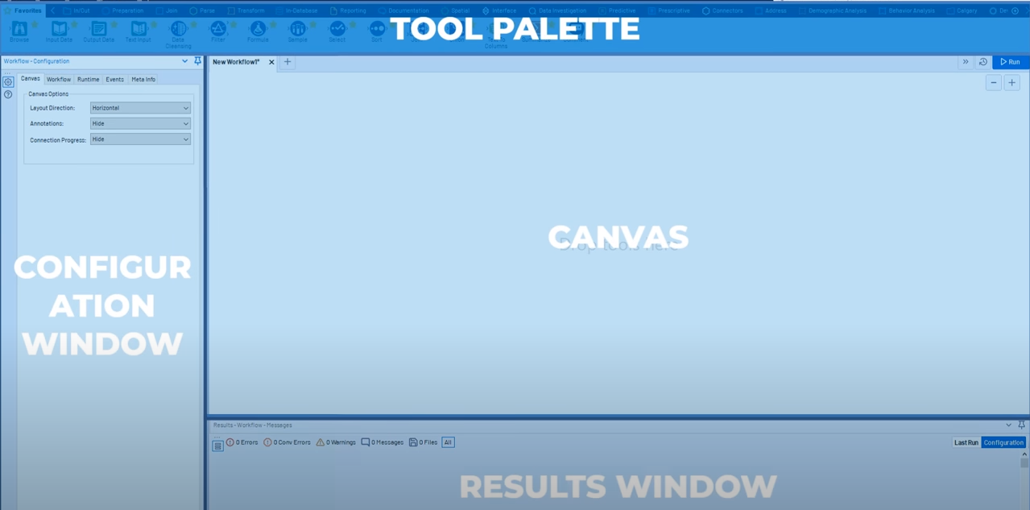
Introduction for Alteryx Designer

Slide 4
Introduction for Alteryx Designer
Using prebuilt tools from tool palette
The workflow configuration window allows users to change properties of selected tools
After finishing the design, the user can run the workflow to get the results
All results, error messages, warnings and other messages are shown in the results window

Slide 5
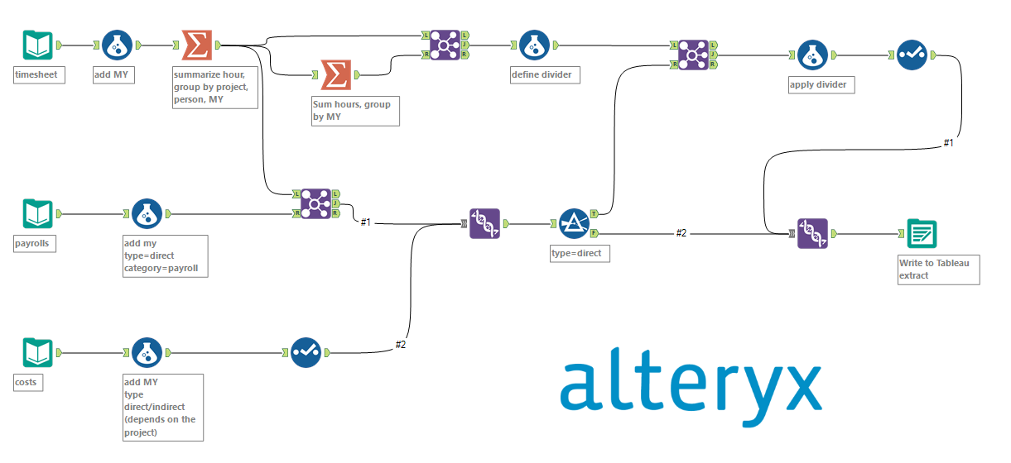
Introduction for Alteryx Designer

Slide 6
Building Workflows
Create a new Workflow: Use File > New Workflow menu. The + sign on the workflow panel also creates a new workflow.
Add Tools: Select any tool from Tool Palette and drag to the workflow canvas.
Delete Tools: Select the tool on canvas and press Delete key on the keyboard or right click and select Delete.
Connect Tools: Drag the output anchor from one tool to the other tool. Connections symbolize the data pipeline in the workflow.
Run.

Slide 7


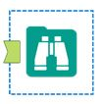
Input/Output Tools
Use Input Data Tool for a file or database.
Click on "Connect to File or Database" drop down in configuration panel to open data connection panel.
A variety of file formats (like csv, txt and zip) are recognized in the Files tab.
A variety of data warehousing tools are recognized in the Data Sources tab.
Use Output Data Tool to write the results of the workflow to a file or database.
Click on "Write to File or Database" drop down in configuration panel to open data connection panel.
Use Browse Tool to view data from a connected tool.
Gives various statistics for all data columns.
Choosing a data column, gives stats on missing data, the data format and counts of different values.

Slide 8




Preparation Tools
Sampling, Sorting, Filtering, Selecting and Cleaning tools.
Use Sampling tool set to prepare the data for analysis.
Use Cleansing tool to remove null rows and columns.
Use Filter tool to select data using a condition.
Use Select tool to select needed columns or specific number of rows in given order, and modify the type and size of data, rename a column, or add a description.
Use Sort tool to sort the data based on values of one or multiple columns in Ascending or descending order.

Slide 9

Join Tools
Use Join toolset to create one dataset from multiple sources with different fields.
Left, inner and right joins are possible.
The tool has three outputs for each possible join.

Slide 10





Transformation Tools
Arrange Tool: Rearrange and break or combine selected fields in new fields.
Count Record Tool: Count rows of data passing through the tool. This is used to monitor the progress of pipelines.
Summarize Tool: Create summaries like sum, count, etc. for each field of the data.
Transpose Tool: Pivots the table on its axis, such that horizontal fields can be viewed vertically.
Weighted Average Tool: Calculates the weighted average of a given field.

Slide 11




Parsing Tools
Parse Datetime: String to date
Parse using Regular Expressions: For a column and a regular expression, use the regex to parse the column.
Text Parser: Breaks string to multiple parts into be placed in multiple columns. It can remove delimiters, quotes, parentheses and brackets.

Slide 12
Demo
Please complete the following tasks:
Step 1: Import “Sample_Historical-Posts-2021-12-31--2022-01-31.csv” (1) and “Sample_Posts_Summary_2021-12-31--2022-01-31.csv” (2)
Step 2: Remove null row in column “Page Name” and “User Name” in data(1)
Step 3: Change the data type in data(1)
Step 4: Only keep rows which have the values equal to “Link” in column “Type” in data(1)
Step 5: Join data (1) and data (2) based on “User Name” and “Codename”, and use “joined” output for next step
Step 6: Create a new column “sum_of_like_comment” and the value equal to sum of column “Like” and “Comments”
Step 7: Sum “sum_of_like_comment” after group by “User Name”
Step 8: Sort the output from Step 7 by descending
Step 9: Save the output from Step 8 as a .csv file

Slide 13
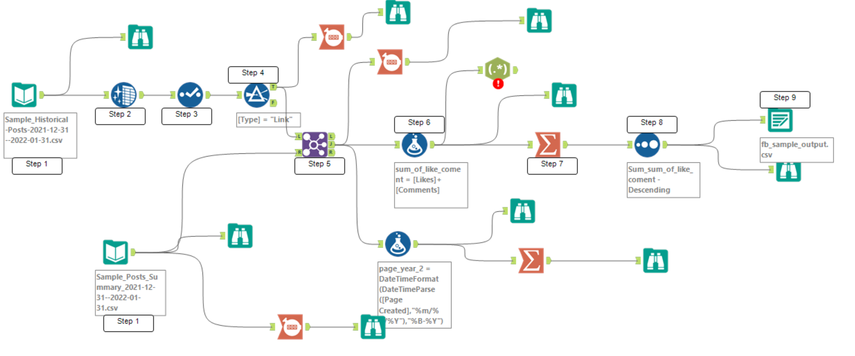
Demo
Left：User Name
Right: Codename

Slide 14
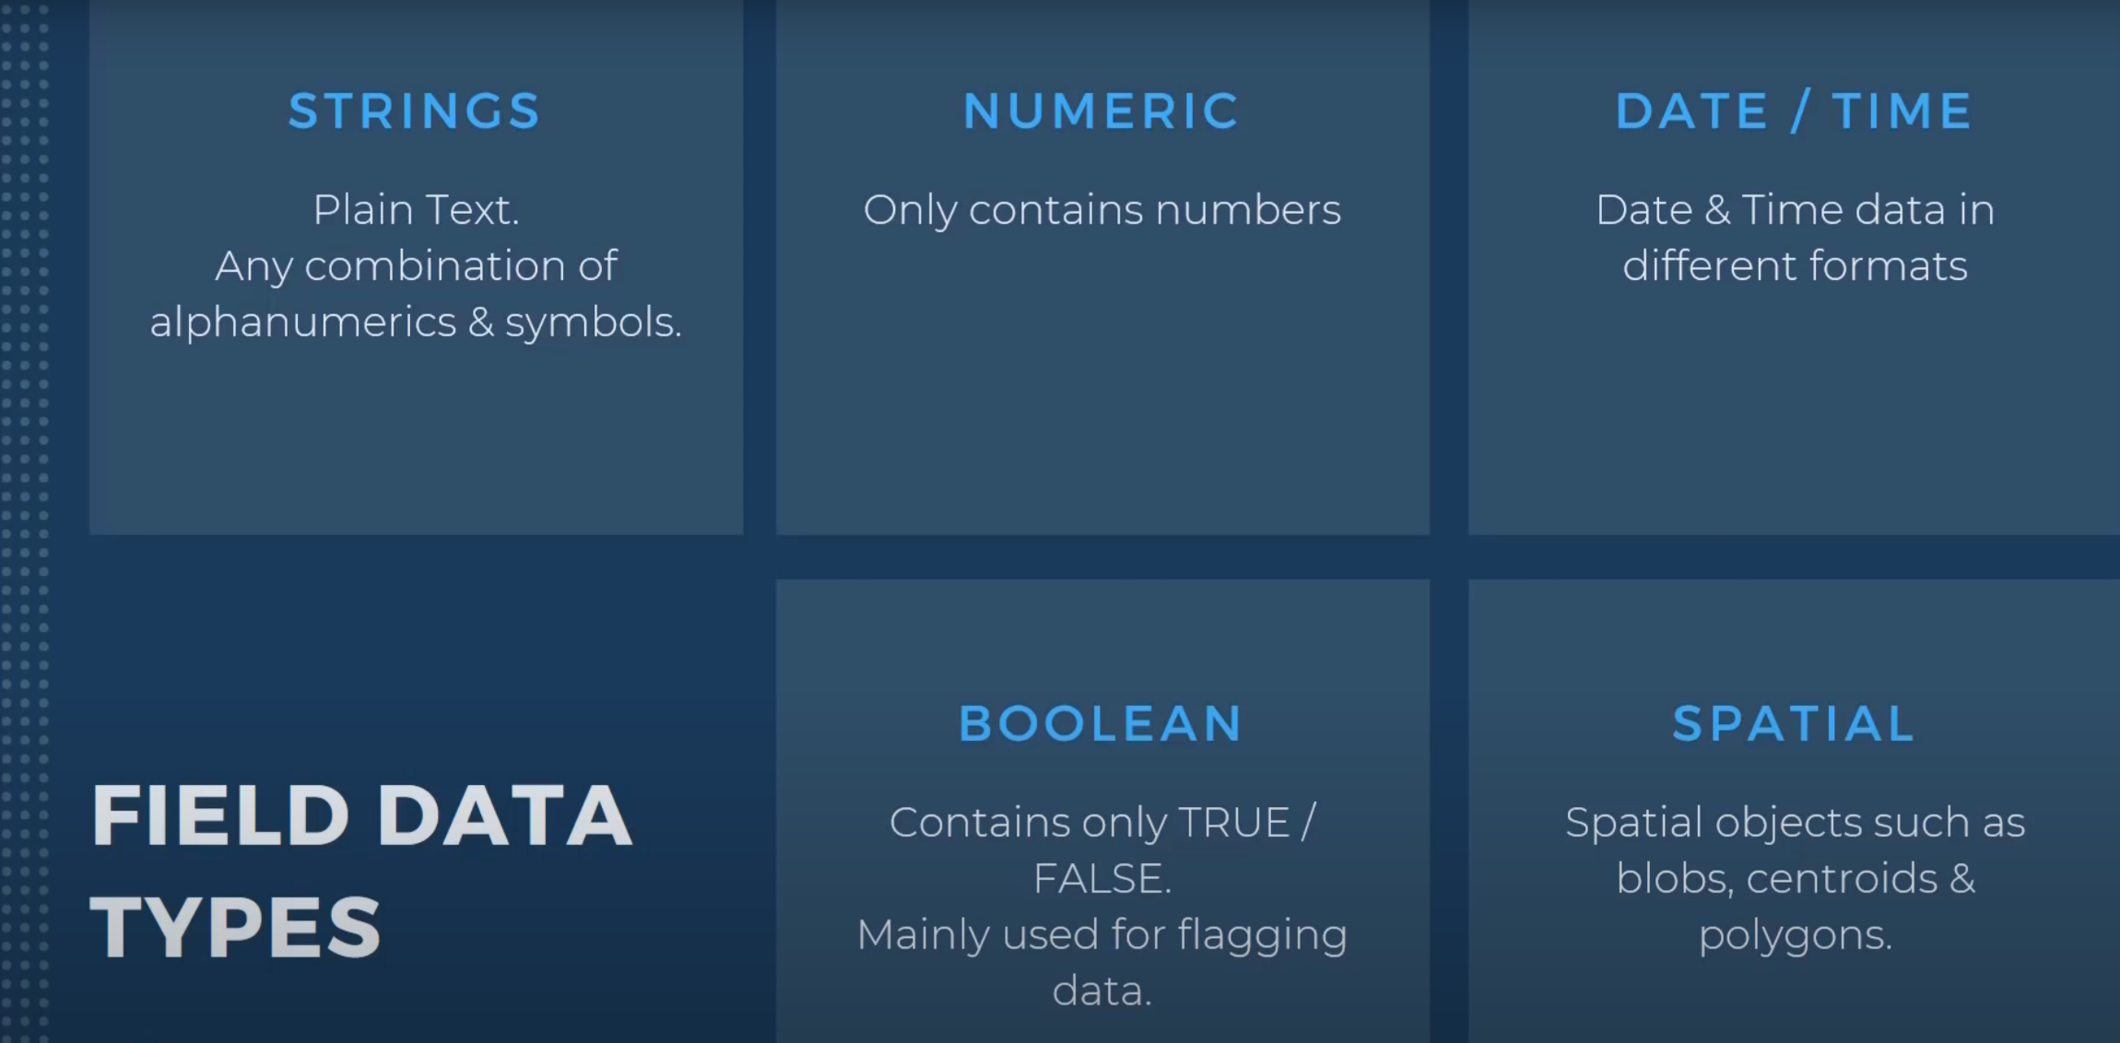
Appendix 1:

Slide 15
Exercise 1：
Two-hour Alteryx tutorial:
https://www.youtube.com/watch?v=YISWJ-G7Zt4
Altreyx Documentation:
https://help.alteryx.com/20221/designer/get-started

Slide 16
Exercise 2：
Historical-Report-2020-01-01--2021-03-01 contains the Facebook posts of a lists of companies. All these posts are related to pandemics. Please use Alteryx to complete the following steps and answer some question:
Clean data: remove the rows which has null value in column “User Name”
Filter out the posts which are from “boston” ( If the “User Name” is “boston”, we should filter these posts out)
Use “Select” tool to change the datatype based on your needs
Group by “User Name” , count how many posts for each Facebook page and answer the question “which 3 Facebook page have the most posts?”
Group by “User Name” , count how many likes for each Facebook page and answer the “which 3 Facebook page have the most likes?”
Group by “User Name” , count how many comments for each Facebook page and answer the question “which 3 Facebook page have the most commented?”
Bonus: Create a new columns, called “my_interaction”, and the value of it is the sum of “Likes”, “Comments” and “Shares” Group by year and month of “post_year” and answer the question “Which three months have the most interaction?”

